Slide 1


Using GTA V as an AI test Environment
David Spalla
Ryan Adams
Brennan Powers

Slide 2
Goal
Short Term Goal: Create a base scenario that can be used to test AI, and implement basic obstacle avoidance for a specific vehicle.
End Goal: Create an algorithm that makes a vehicle obey all the laws of the road using the ground works from this project.
Extra Goal: Create a matlab script that can animate point cloud files obtained from LiDAR

Slide 3
Resources
DeepGTAV
VPilot
GTAV LiDAR
OpenIV
Python

Slide 4
Problems
-How to have python scripts communicate with GTA
-Vehicle moves to fast for LiDAR
-Decrypt hidden GTA files for modifying game data
-Create Lidar files quick enough before next is taken
-Manipulate the environment for best test results
-Placement of LiDAR
-Create an easy way to visualize the LiDAR results

Slide 5
Solutions
Use DeepGTA to connect to port 8000 of GTA to send messages
Use motorcycle for smallest LiDAR footprint
Limit max speed of motorcycle
Create static scenario for testing
Use OpenIV to find hidden files
Streamline point cloud file manipulation for time efficiency between LiDAR samples

Slide 6
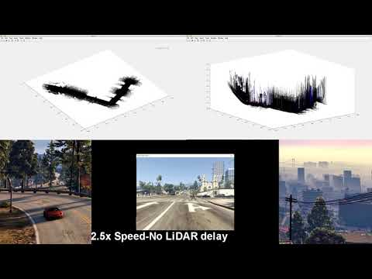
Video Example
This video demonstrates how the LiDAR system works.
Please note that the car is user controlled in this video.
Black Dots - Indestructible objects
Red Dots - Vehicles
Blue Dots - Destructible objects

Slide 7
Questions?

